Slide 1

Text Classification
Applied Text Mining, from Foundations to Advanced
Robert Bagheri
2026
Notes:
Video by Google DeepMind from Pexels: https://www.pexels.com/video/an-artist-s-animation-of-artificial-intelligence-ai-this-video-depicts-language-models-which-generate-text-it-was-created-by-wes-cockx-as-part-of-the-visualising-ai-project-launched-by-18069700/

Slide 2
From before
Text preprocessing
Tokenization
Token removal
Stemming
Text representation

Slide 3
This lecture
Text classification
Classification pipeline
Classification algorithms
Evaluation

Slide 4
Text Classification
Notes:
The theme of this course
4

Slide 5
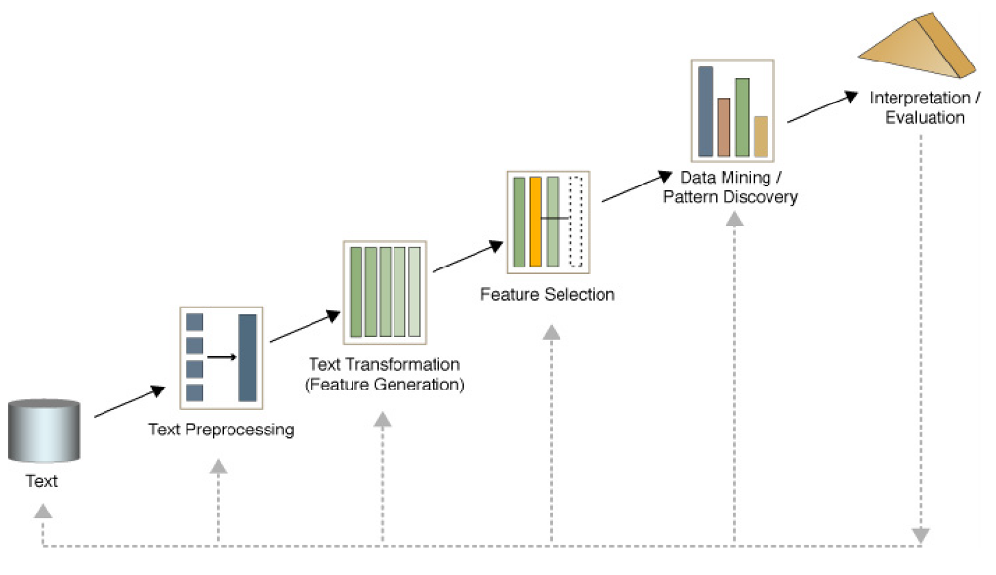
Text mining process

Slide 6
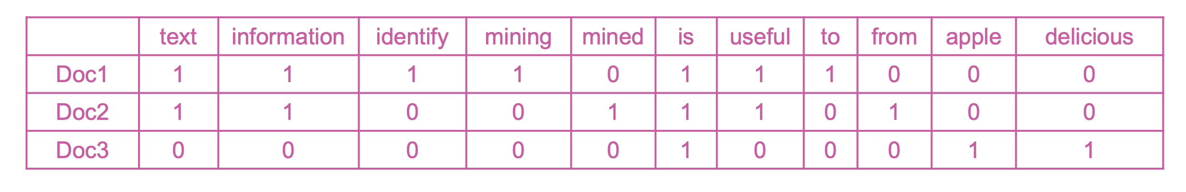
Text transformation, feature generation Bag-of-Words representation
Doc1: Text mining is to identify useful information.
Doc2: Useful information is mined from text.
Doc3: Apple is delicious.
Document-Term matrix (DTM):

Slide 7
Text classification
Supervised learning: Learning a function that maps an input to an output based on example input-output pairs.
infer a function from labeled training data
use the inferred function to label new instances
Human experts annotate a set of text data
Training set
Document | Class
Email1….. | Not spam
Email2…. | Not spam
Email3…. | Spam
… | …

Slide 8
Applications
Assigning subject categories, topics, or genres
Spam detection
Authorship identification
Age/gender identification
Language Identification
Sentiment analysis

Slide 9
Quiz?
Which one is not a text classification task? (less likely to be)
Author's gender detection from text
Finding about the smoking conditions of patients from clinical letters
Grouping similar news articles
Classifying reviews into positive and negative sentiment

Slide 10
Terminology
Features: information which is used to separate data into classes
Prediction: the output of the model, which can be compared to the correct labels (our ground truth)
Parameters: the data in the model
Training: fitting parameters to the data
Hyperparameters: the “settings” of the model; these are choices made by you

Slide 11
Types of classification
Binary classification:
Definition: Involves two categories or classes.
Examples: True/False, Yes/No, Spam/Not Spam, Positive/Negative sentiment.
Multiclass classification:
Definition: Involves more than two categories or classes.
Examples: Classifying animals into Cats/Dogs/Birds, predicting the genre of a book (e.g., Fiction/Non-fiction/Science/History).
Multilabel classification:
Definition: Each instance can belong to multiple classes simultaneously.
Examples: Tagging a research article with multiple topics like "Machine Learning," "Natural Language Processing," and "Healthcare.”, Assigning multiple genres to a book.

Slide 12
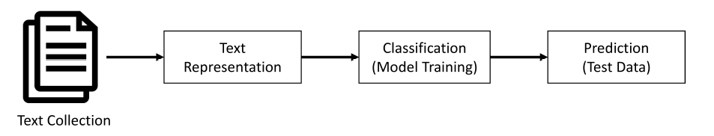
Simple pipeline

Slide 13
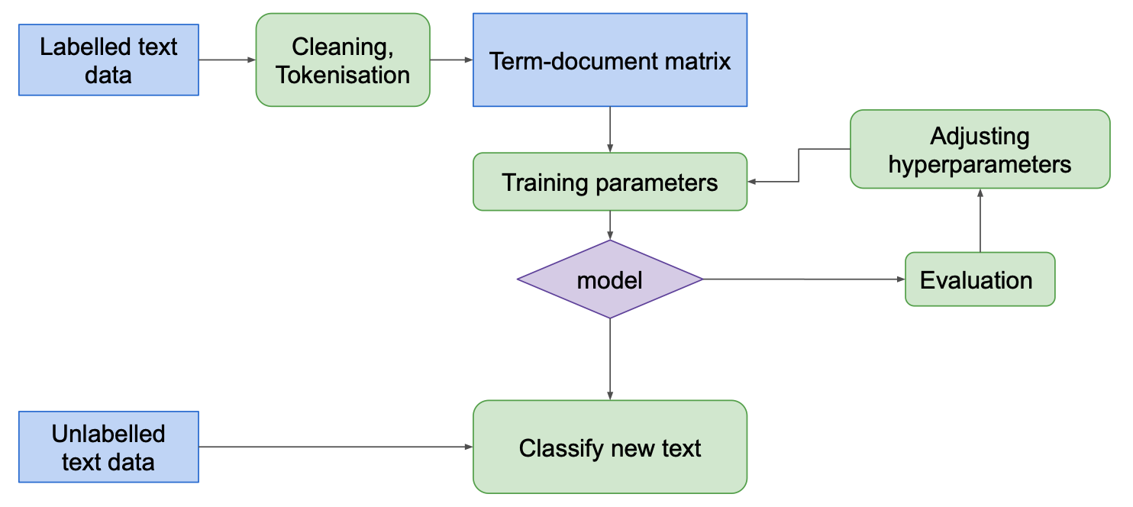
Opening the pipeline

Slide 14
Preparing data
Data collection
Text pre-processing
Data splitting
Training
Validation (development)
to tune the hyperparameters
Test
Text representation

Slide 15
Data splitting
Methods:
Train-Test Split
Split the dataset into two parts: training and testing (e.g., 80%-20%).
K-fold cross validation
Split the dataset into K non-overlapping folds of approximately equal size.
Leave-One-Out Cross-Validation
A special case of K-Fold where K=N (number of data points).

Slide 16
K-fold cross validation
Purpose:
Evaluates the performance of a model on unseen data by splitting the dataset into K subsets (folds).
Ensures that every data point gets a chance to be in both the training and validation sets.
How it Works:
Split the data into K equally-sized folds.
Train the model on K−1 folds and validate it on the remaining fold.
Repeat the process K times, each time using a different fold for validation.
Advantages:
Reduces the risk of overfitting compared to a single train-test split.
Provides a more robust estimate of the model’s generalization performance.

Slide 17

K-fold cross validation
https://scikit-learn.org/stable/modules/cross_validation.html

Slide 18
How to classify this document?
Documents by vector space representation
?
Sports
Politics
Finance

Slide 19
Text Classification: definition
Input:
a document d
a fixed set of classes C = {c₁, c₂,…, c_{J}}
Output: a predicted class c ∈ C

Slide 20
Classification Algorithms
Notes:
The theme of this course
20

Slide 21
Hand-coded rules
Rules based on combinations of words or other features
Accuracy can be high: If rules carefully refined by expert
But building and maintaining these rules is expensive
Data/Domain specifics

Slide 22
Supervised Machine Learning
Input:
a document d
a fixed set of classes C = {c₁, c₂,…, c_{J}}
A training set of m hand-labeled documents (d₁,c₁),....,(d_{m},c_{m})
Output:
a learned classifier y:d → c

Slide 23
Common algorithms
K-nearest neighbors
Naïve Bayes
Logistic regression
Support vector machines
Neural networks
Deep learning

Slide 24
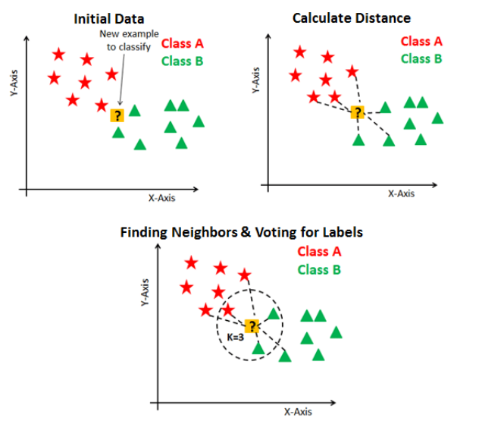
K-nearest neighbors
K-Nearest Neighbors (KNN) is a simple, non-parametric algorithm that classifies data points based on the majority class of their K nearest neighbors in feature space, using a distance metric such as Euclidean distance.
Non-parametric methods: make no strong assumptions about the data's underlying distribution.

Slide 25
Naive Bayes
Naive Bayes is a probabilistic machine learning algorithm based on Bayes' Theorem, which assumes that all features are independent of each other (a "naive" assumption) and uses this simplification to classify data efficiently.
great | 2
love | 2
recommend | 1
laugh | 1
happy | 1
... | ...
y(
)=c

Slide 26
Bayes’ rule
For a document d and a class c

Slide 27
Learning naive Bayes
MAP is “maximum a posteriori” = most likely class
Bayes Rule
Dropping the denominator

Slide 28
Learning naive Bayes
Document d represented as features x1..xn
Could only be estimated if a very, very large number of training examples was available.
We can just count the relative frequencies in a corpus

Slide 29
Learning naive Bayes
Sec.13.3
Simply use the frequencies in the data

Slide 30
Neural networks, “deep learning”
Neural networks are machine learning models inspired by the structure of the human brain, consisting of layers of interconnected nodes (neurons) that process and learn patterns in data by adjusting weights through a process called backpropagation.
Compositional approach to curve-fitting;
“Biologically inspired”
(but don’t take that too seriously);
Sound cool.

Slide 31
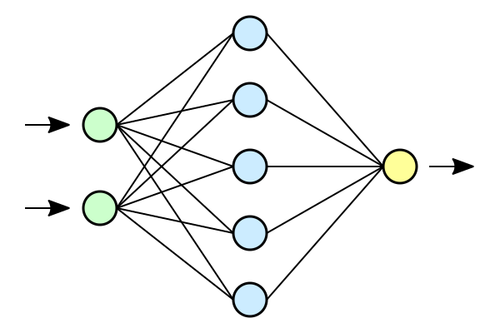
Neural network

Slide 32
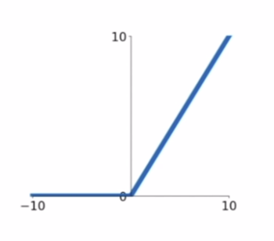
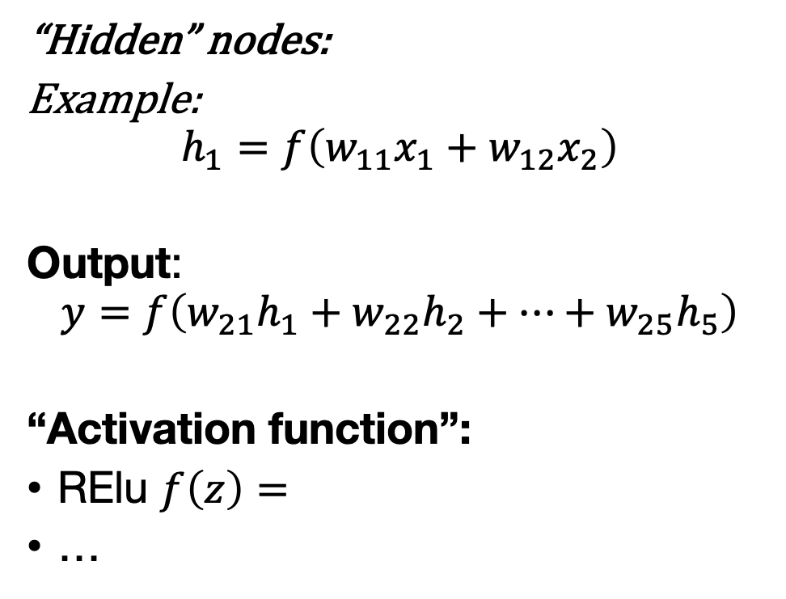
Neural network
“Hidden” nodes:
Example:
$$h_{1}=f\left(w_{11}x_{1}+w_{12}x_{2}\right)$$
Output:
$$y=f\left(w_{21}h_{1}+w_{22}h_{2}+…+w_{25}h_{5}\right)$$
“Activation function”:
RElu $f\left(z\right)=$
…

Slide 33
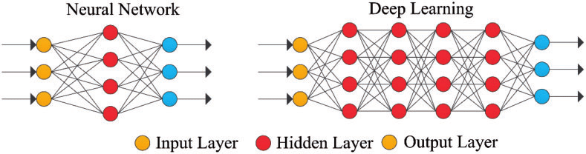
What makes a neural net “deep”?

Slide 34
More on neural networks
Wednesday, Thursday and Friday!

Slide 35
Ensemble classifiers
We can combine multiple classifiers
Random forest classifier
fit multiple decision trees, average over predictions
Less “volatile” than a single decision tree
Voting classifier
Fit multiple classifiers and let them “vote” on the result
Classifiers may be of different classes!

Slide 36
Selecting hyperparameters
A hyperparameter is a parameter whose value is used to control the learning process, which must be configured before the process starts.
Experts input
Hyperparameter optimization: the selection process will be automated
Random search
Grid search: systematically go through your data
Other optimization techniques

Slide 37
Evaluation
Notes:
The theme of this course
37

Slide 38
No free lunch
“Any two optimization algorithms are equivalent when their performance is averaged across all possible problems”
(Wolpert & MacReady)

Slide 39
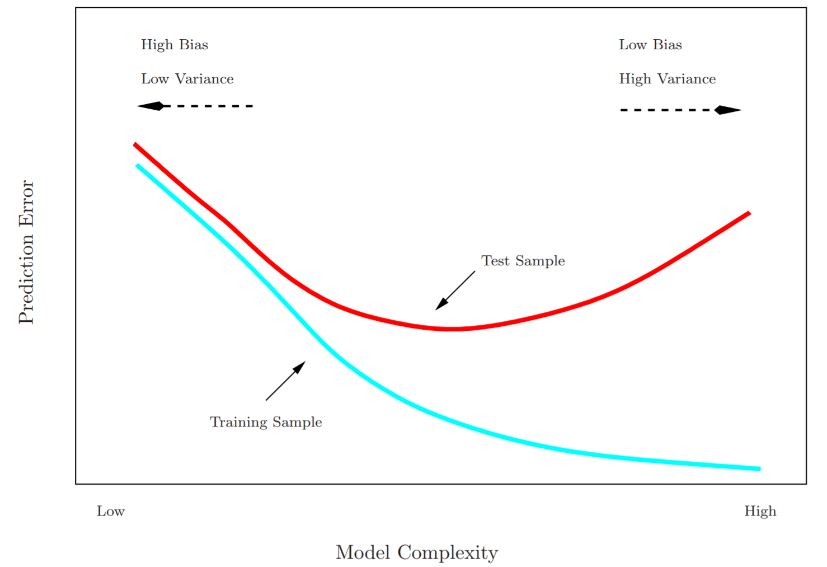

Slide 40
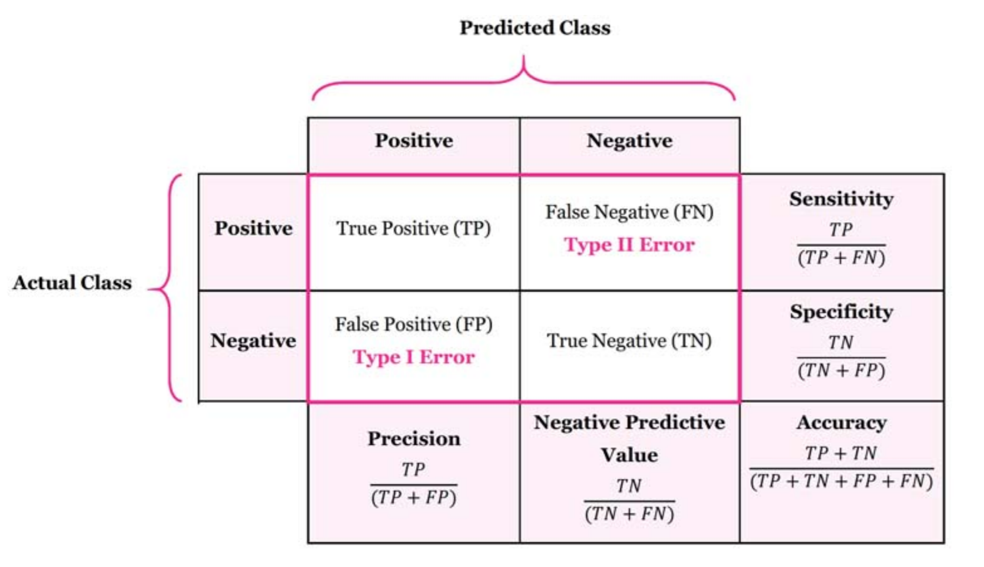
Confusion matrix

Slide 41
Accuracy
Accuracy is a valid choice of evaluation for classification problems which are well balanced and not skewed.

Slide 42
Precision and recall
Precision: % of selected items that are correct Recall: % of correct items that are selected
Precision is a valid choice of evaluation metric when we want to be very sure of our prediction.
Recall is a valid choice of evaluation metric when we want to capture as many positives as possible.

Slide 43
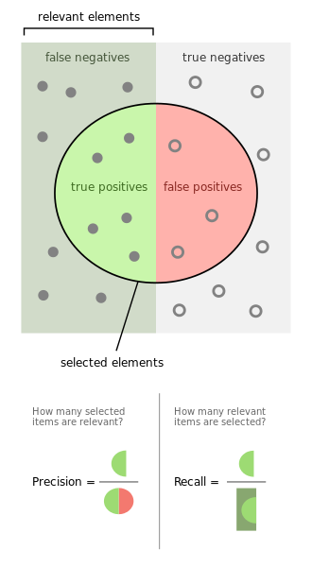
Source: https://en.wikipedia.org/wiki/F-score

Slide 44
A combined measure: F
A combined measure that assesses the P/R tradeoff is F measure (weighted harmonic mean):
The harmonic mean is a very conservative average
People usually use balanced F1 measure
i.e., with β = 1 (that is, α = ½): F = 2PR/(P+R)

Slide 45
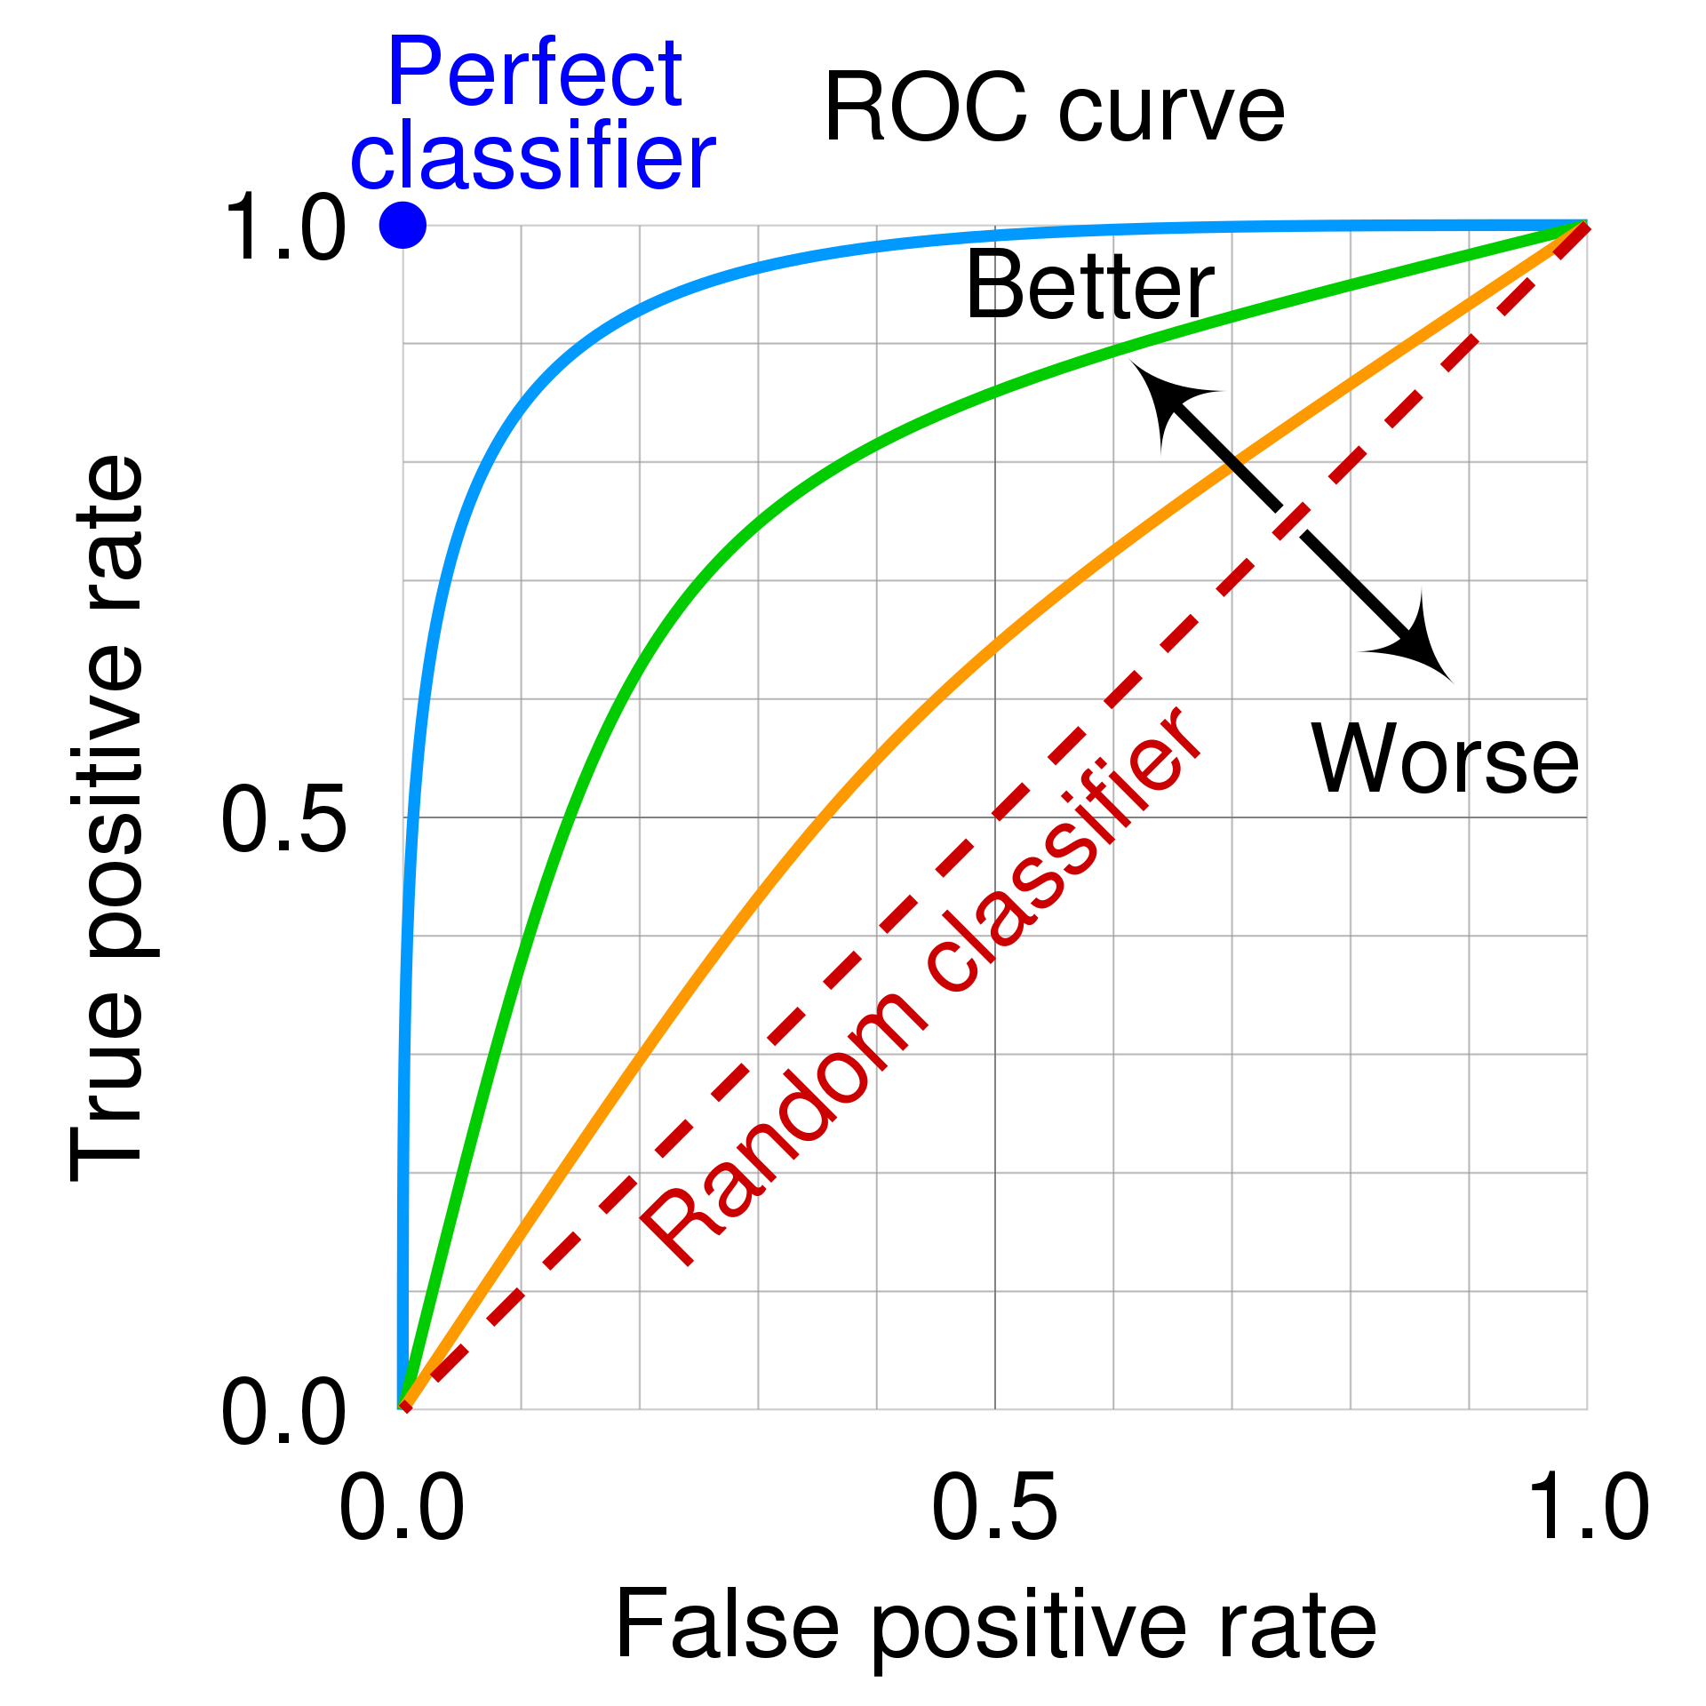

Slide 46
Evaluation metrics: multiclass classification
Evaluation is less straightforward with multiple classes
Precision/recall/F1 per class
But what if we want a single score?
Macro F1: average of F1 score for each class
Micro F1: uses total number of true/false positives/negatives

Slide 47
Conclusion
Understanding the classification pipeline is essential for building effective models, from preprocessing text data to training and evaluation.
There are different algorithms available for text classification, each with its strengths.
Accurate evaluation using metrics like accuracy, precision, recall, and cross-validation ensures reliable model performance and generalization to unseen data.

Slide 48
Practical 2

Slide 49
Questions?

